Slide 1
프로그래밍 언어들의 자료구조는 어떻게 구현되어 있을까?
나는 궁금하다.
이호준

Slide 2
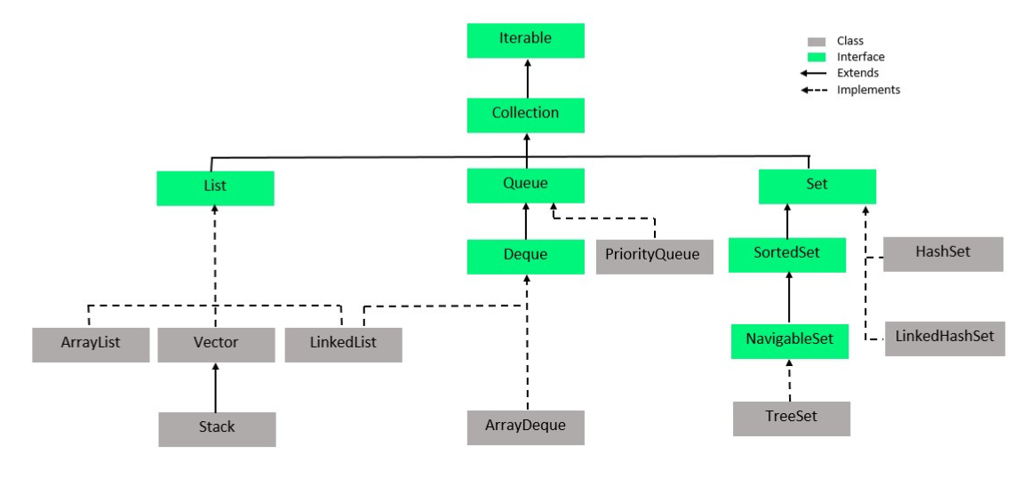
Java Collection Framework

Slide 3
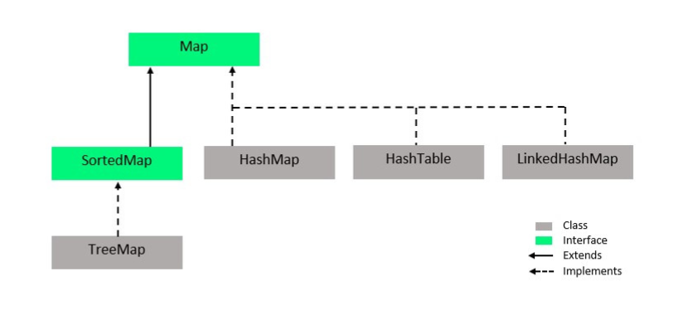
Java Map Interface

Slide 4
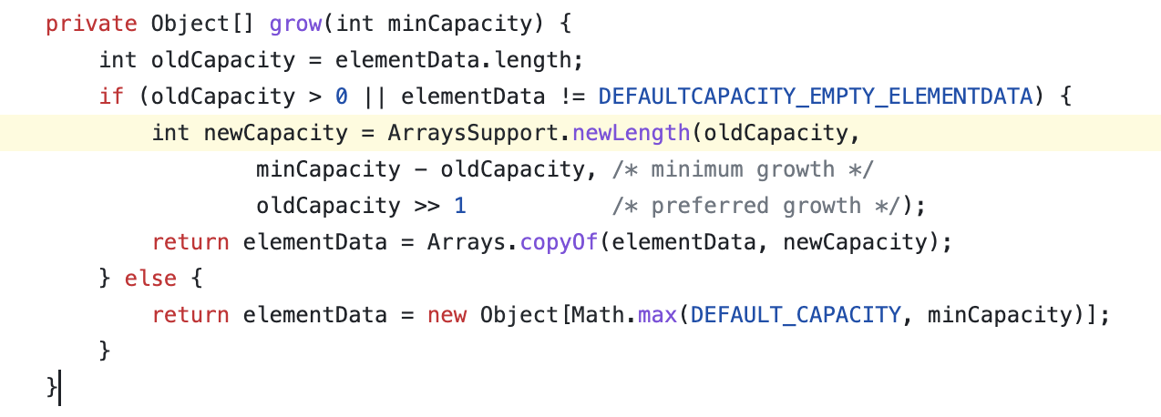
Java
▣ ArrayList
As elements are added to an ArrayList, its capacity grows automatically.
Default Capacity = 10;

Slide 5
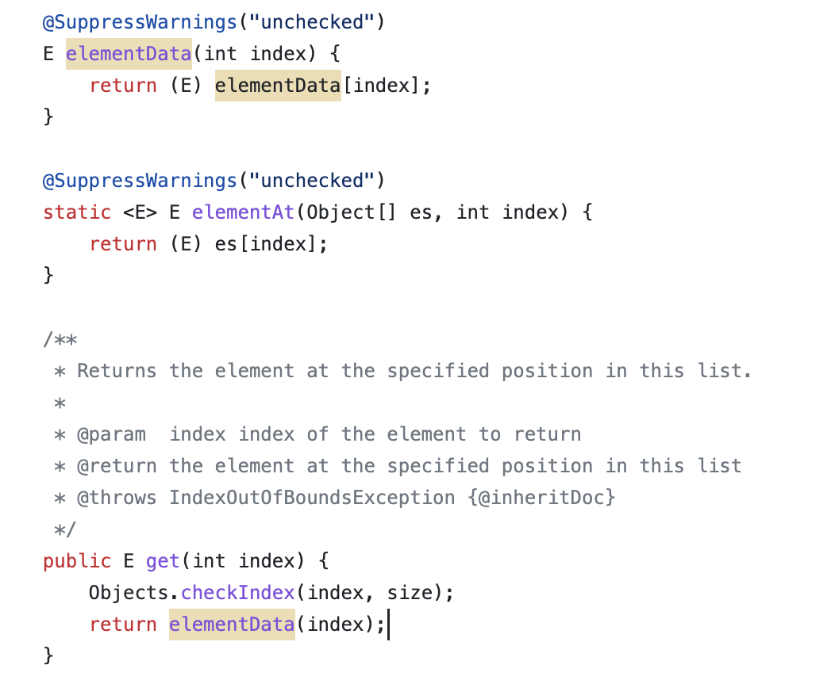
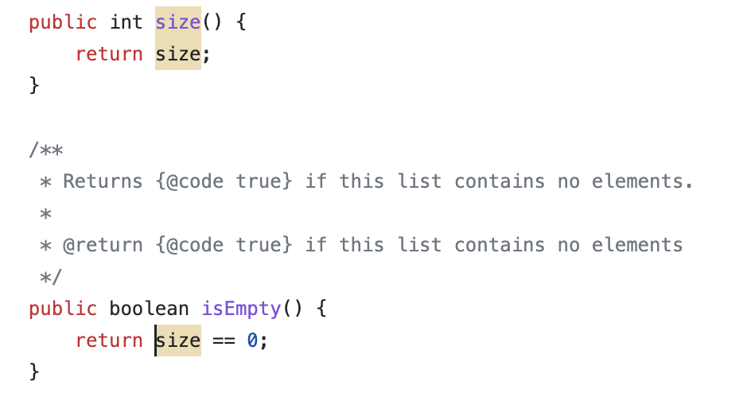
Java
▣ ArrayList

Slide 6
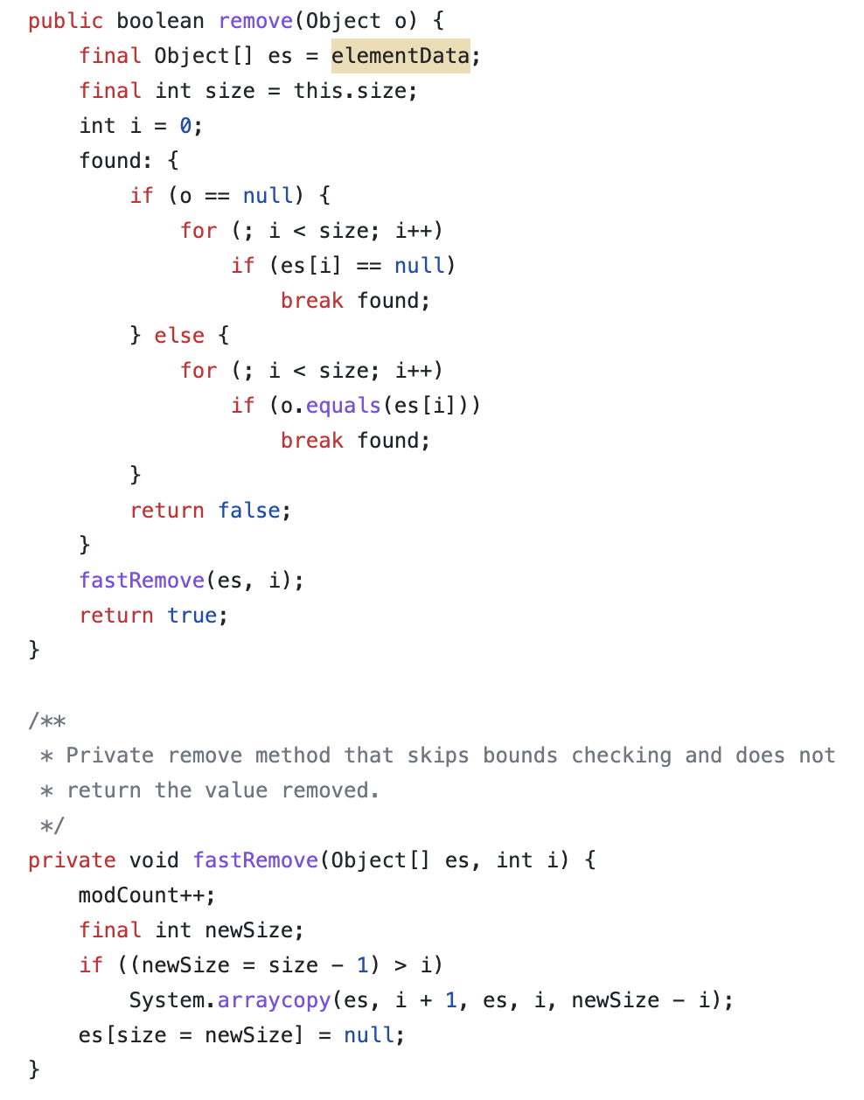
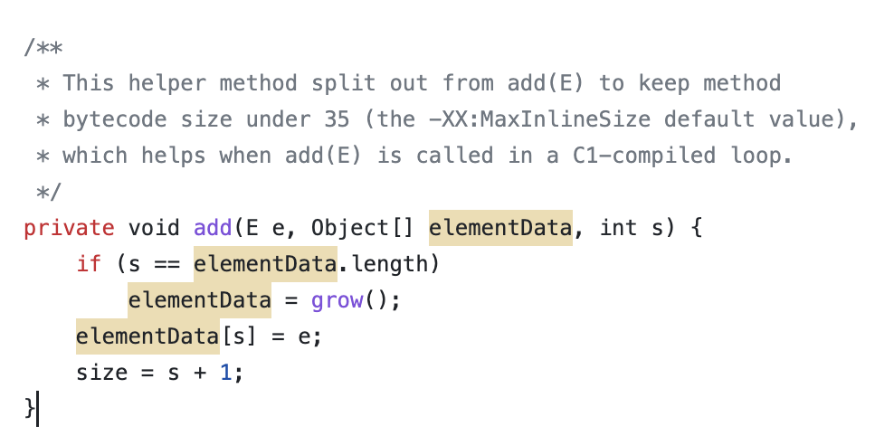
Java
▣ ArrayList

Slide 7
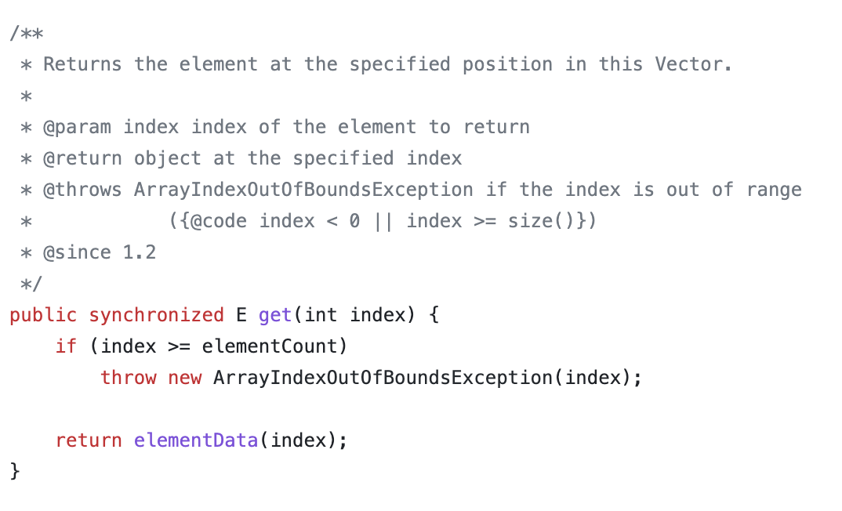

Java
Add, Remove, Get etc…
▣ Vector

Slide 8
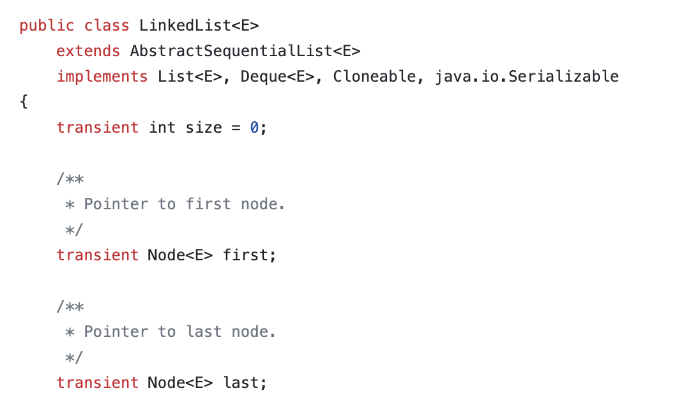
Java
▣ LinkedList (Doubly-Linked List)
Queue<Integer> q = new LinkedList<>();

Slide 9
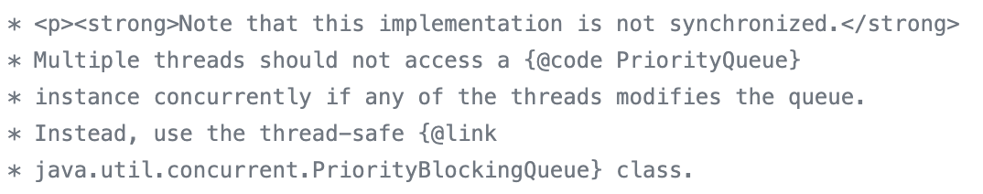
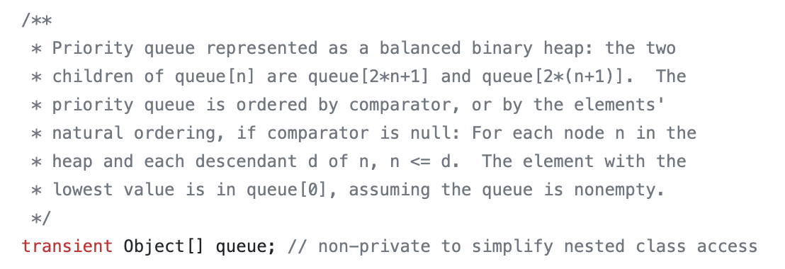
Java
그렇다면!!!
PQ (Heap)은 Balanced 한가요??
▣ PriorityQueue
(Default : Min Heap)

Slide 10
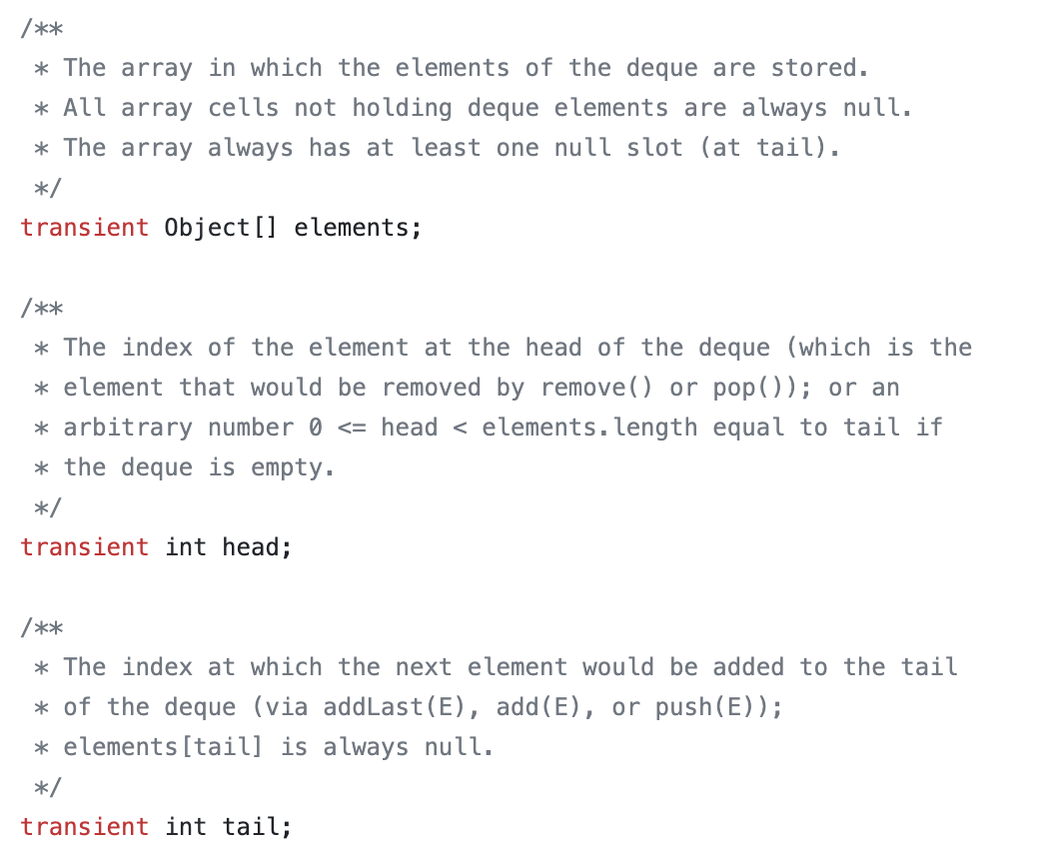
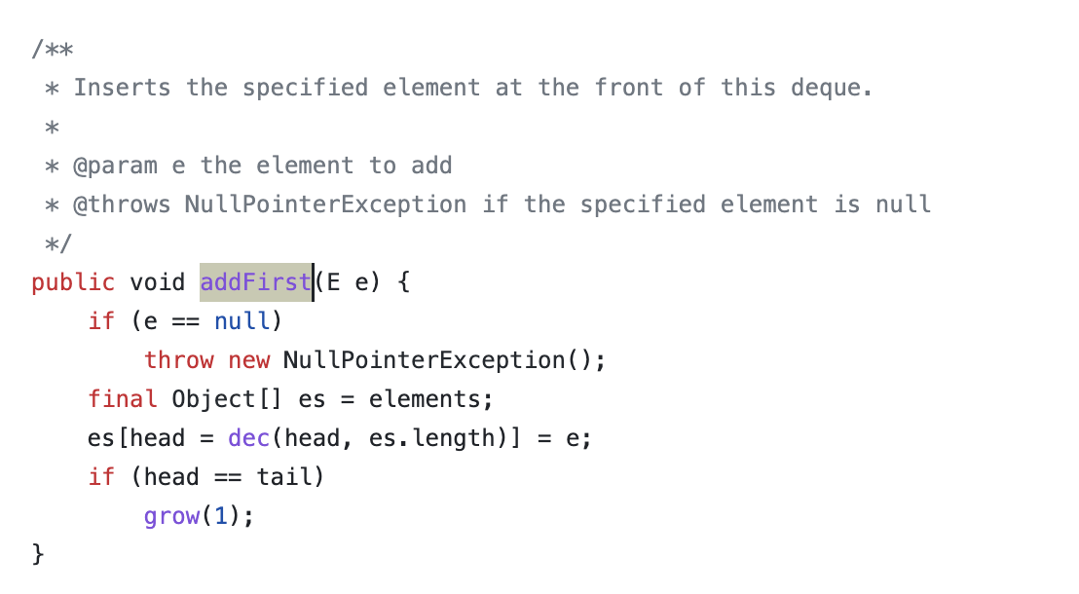
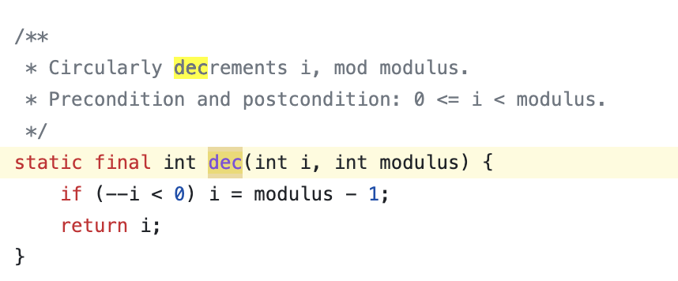
Java
▣ ArrayDeque

Slide 11
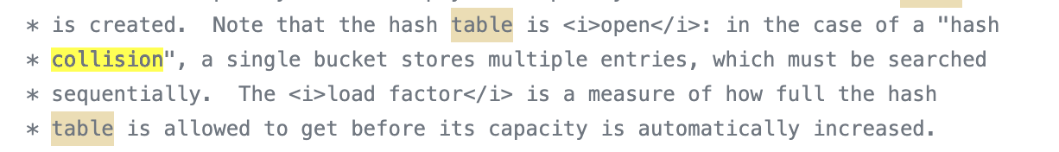
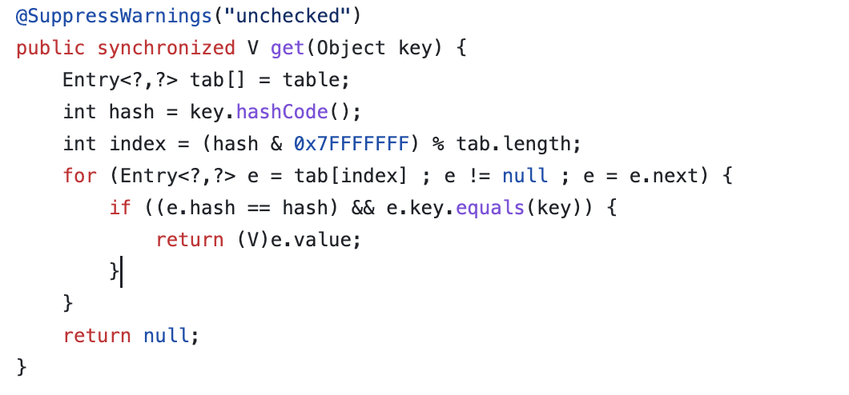
Java Map Container
▣ HashTable

Slide 12
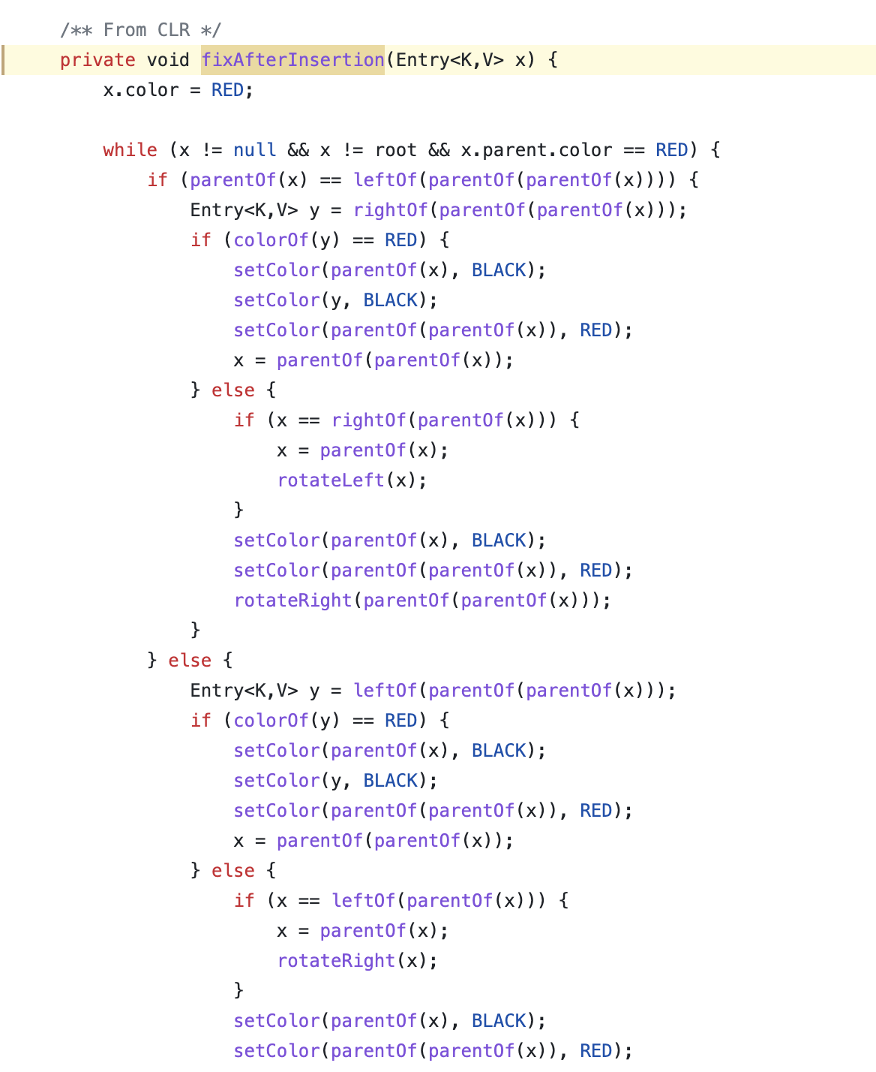
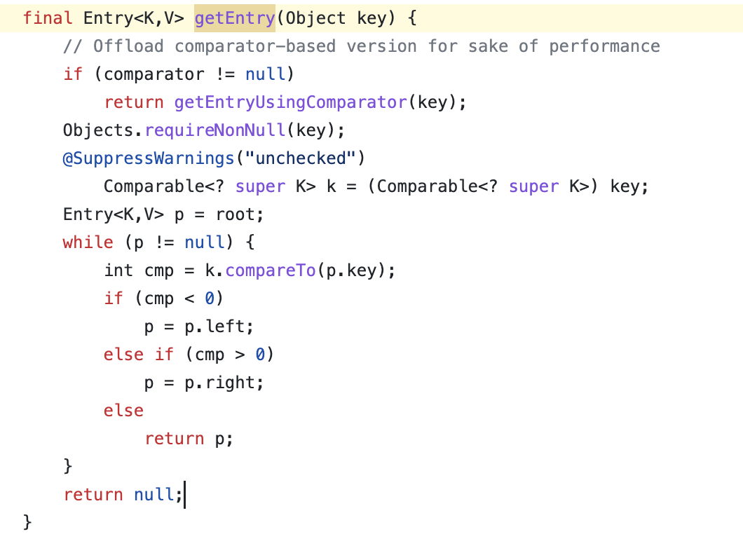
Java Map Container
▣ TreeMap (Red-Black Tree)

Slide 13
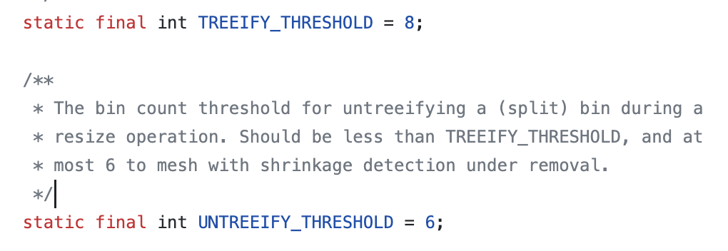
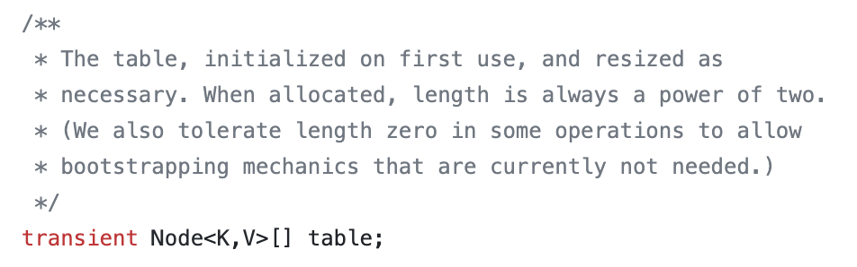
Java Map Container
▣ HashMap
하나의 해시 버킷에 8개의 키-값 쌍이 모이면 링크드 리스트를 트리로 변경한다. 만약 해당 버킷에 있는 데이터를 삭제하여 개수가 6개에 이르면 다시 링크드 리스트로 변경한다.

Slide 14
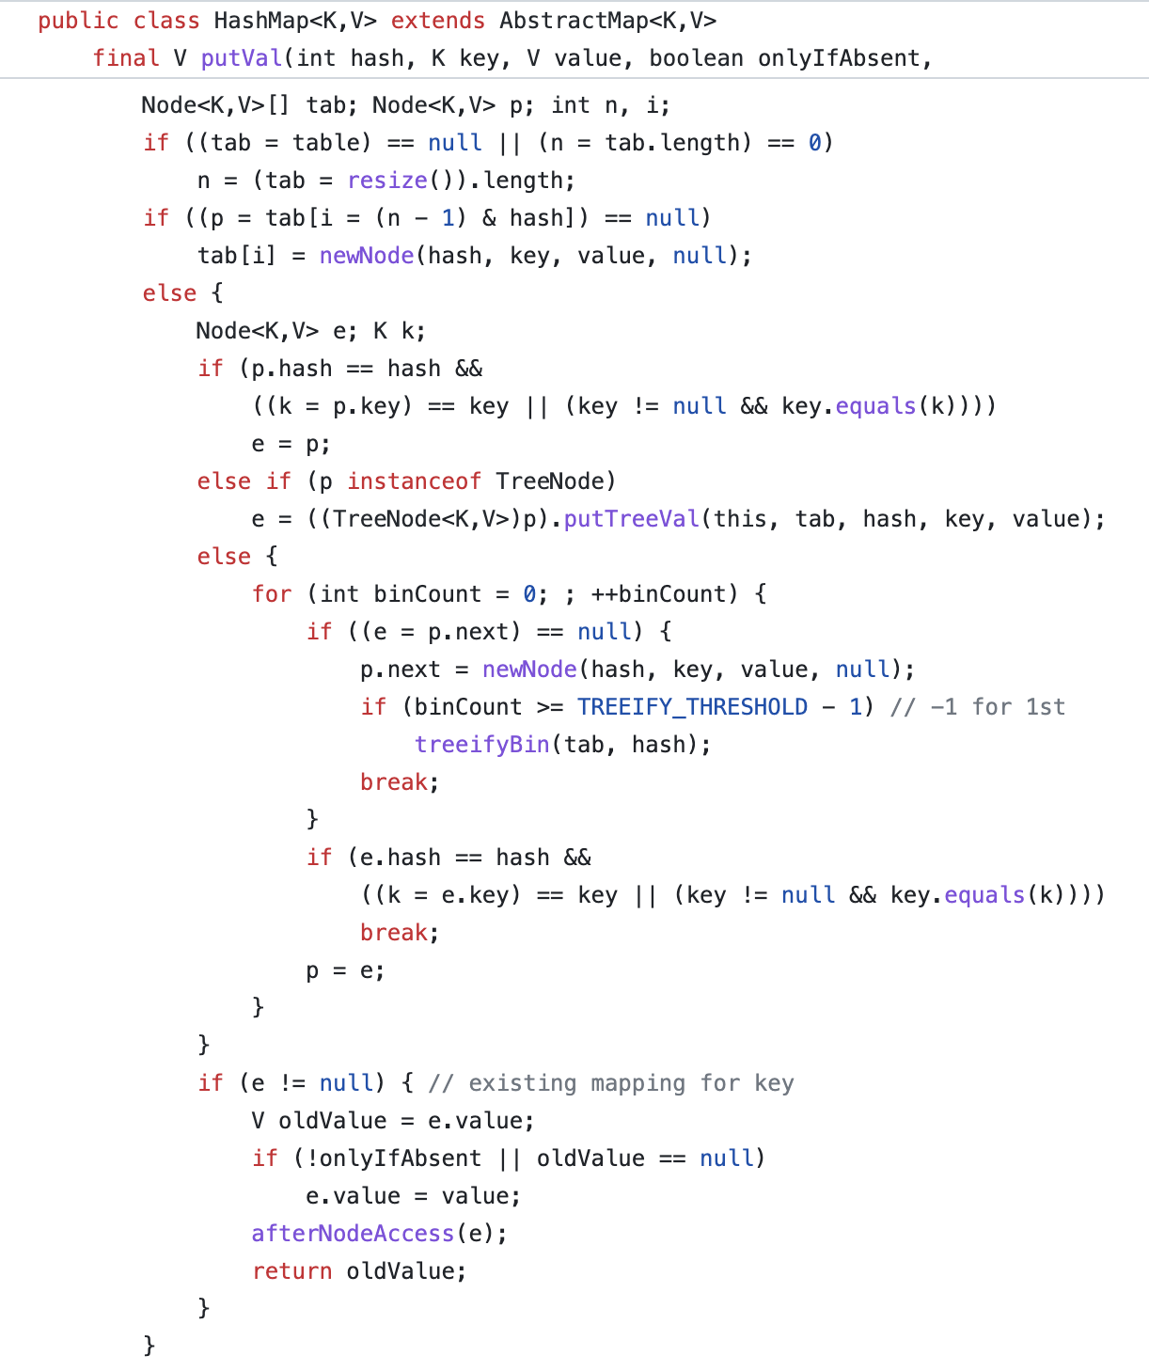

Slide 15
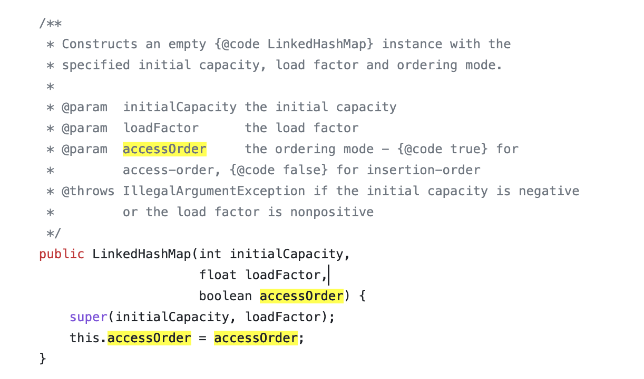
Java Map Container
▣ LinkedHashMap (extends HashMap)
doubly-linked list
입력 순서를 보장
LRU Cache

Slide 16
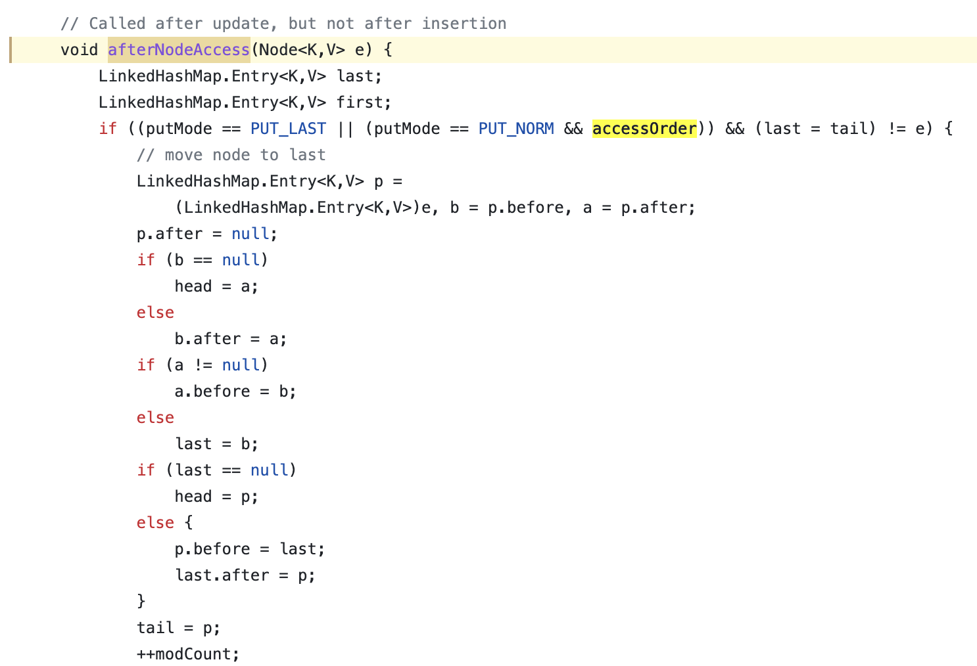

Slide 17
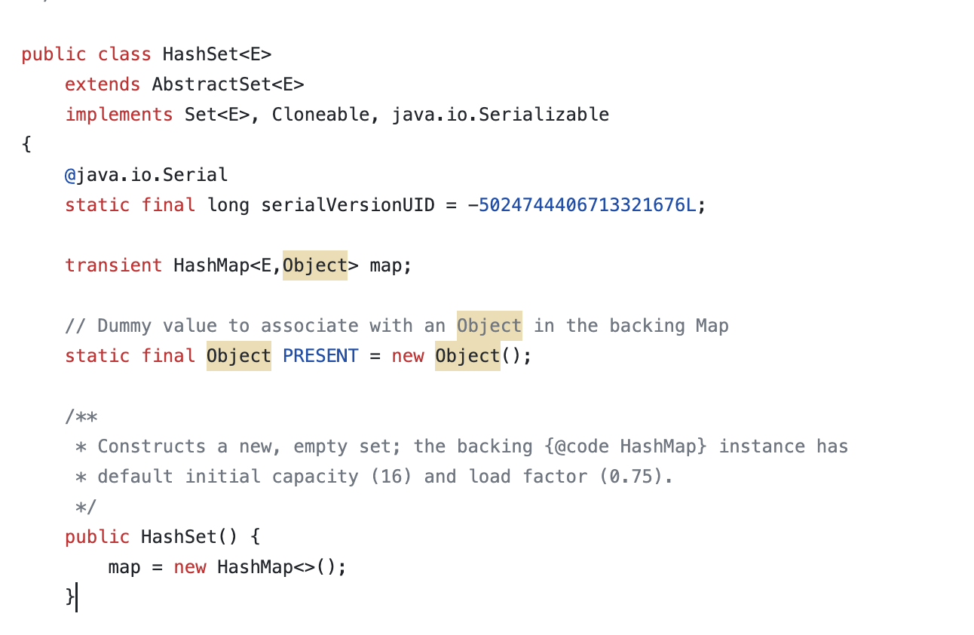
Java Set
▣ HashSet (HashTable)

Slide 18
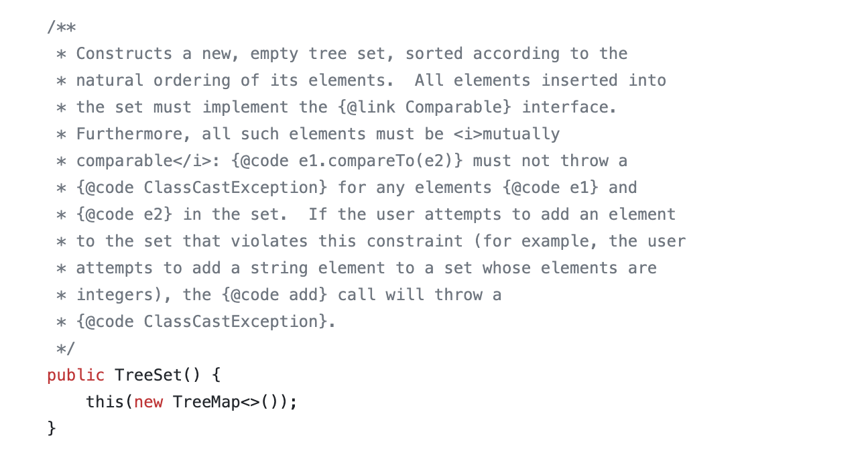
Java Set
▣ TreeSet

Slide 19
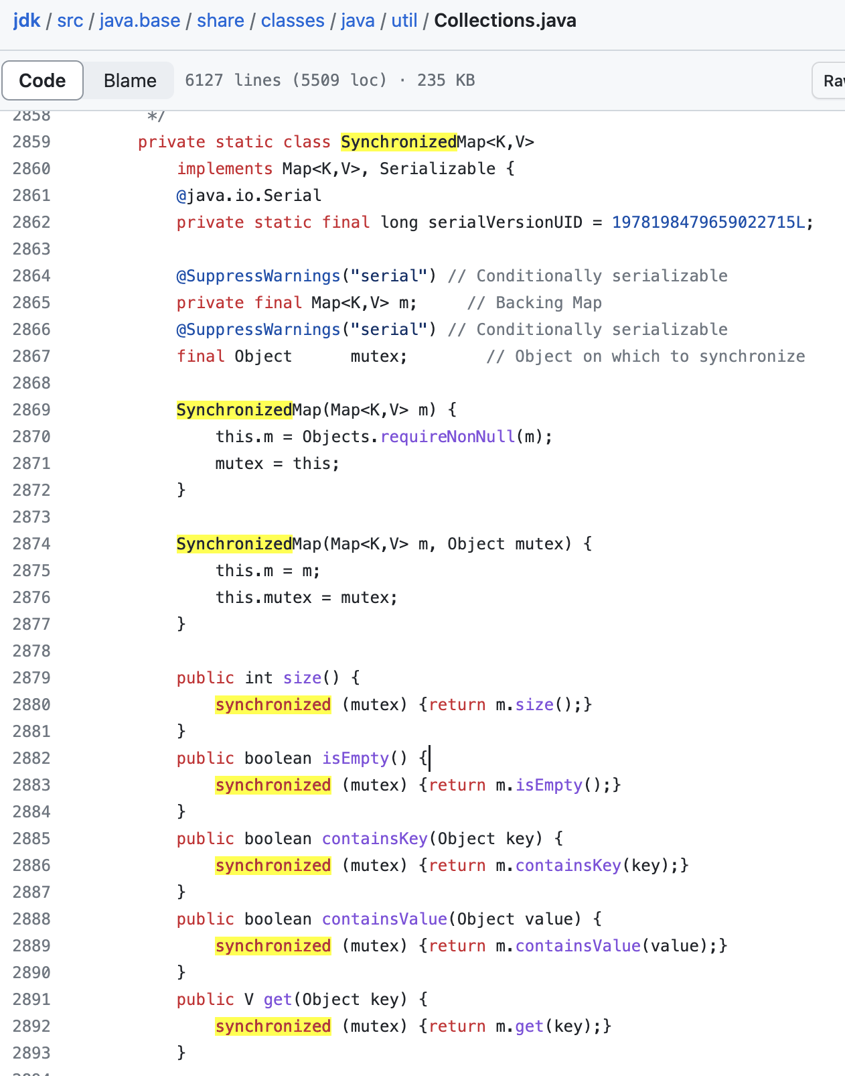
Java Synchronized Collections

Slide 20
C++ STL Container
▣ ’Map’
Red-Black Tree
▣ ’Unordered_map’
Hash Table ( is an array-like data structure that holds buckets or slots. is divided into buckets, where each bucket represents a slot in the hash table)
Collision Handling
Separate Chaining : each slot in the hash table contains a linked list or another data structure to store multiple key-value pairs that hash to the same slot. (find, rehash 함수)
Rehashing
As the number of elements in the unordered_map grows, the container may automatically rehash and resize the bucket array to maintain an appropriate load factor.

Slide 21
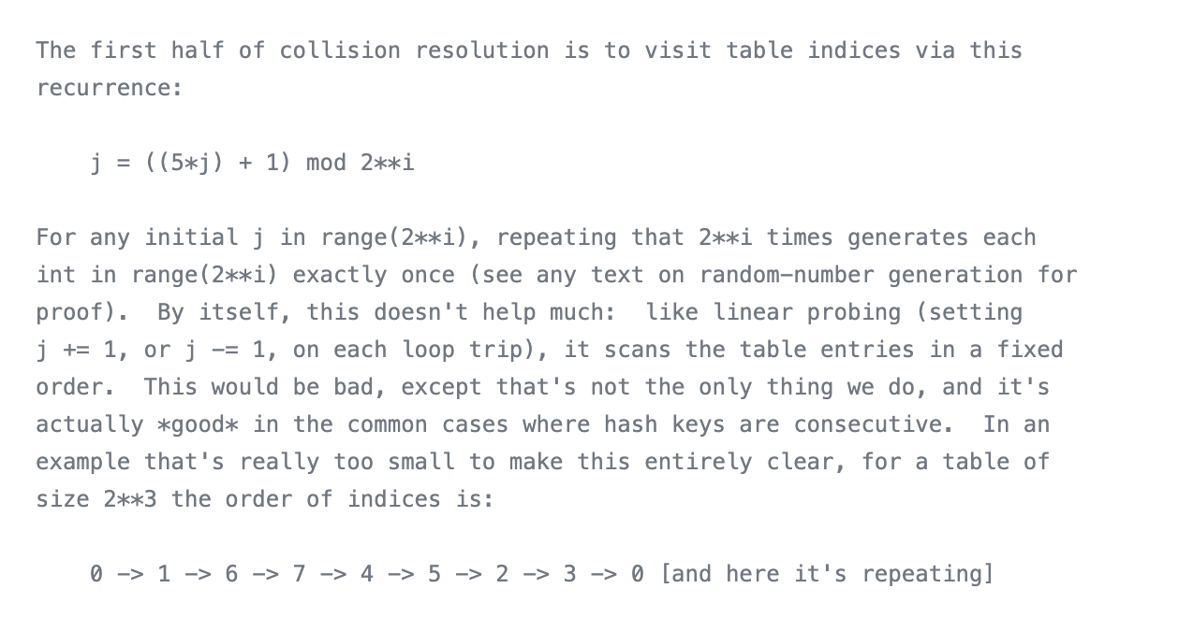
Python
▣ Dict
Hash Table
Collision handling (Open addressing method)

Slide 22
Reference
https://github.com/llvm/llvm-project/tree/main/libcxx/include/__tree
https://github.com/python/cpython/blob/v3.9.1/Objects/dictobject.c#L133
https://github.com/openjdk/jdk/blob/master/src/java.base/share/classes/java/util/ArrayList.java

Slide 23
Q & A

